Slide 1
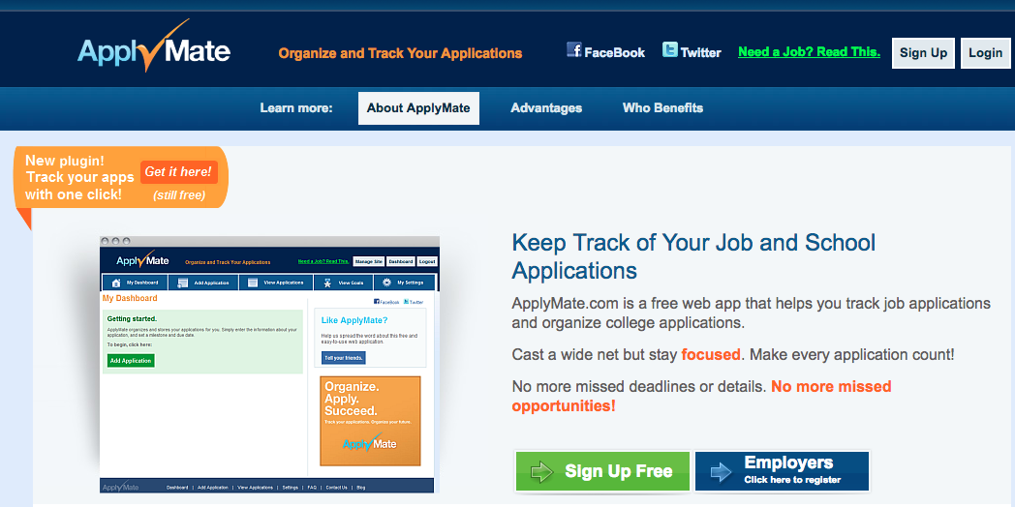
Usability Testing w/ applymate.com
By
Chris, Ram, Dipika, Zalak

Slide 2
The tasks:
Login
Create job profile
Add job application
Sync Calendar
Upload Resume
Update profile
Set target for applications for 12/15/17

Slide 3
Participants Surveyed
We surveyed 12 participants. Mostly in the age range 20-30. We ran the questionnaire first, so that they become familiar with what the testing was about. After the questionnaire, we made the participants to navigate through the website, and do the tasks mentioned in ‘Task description section’. After that we interviewed the participants. We ran an unstructured interview.

Slide 4
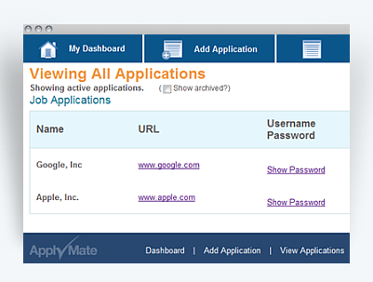
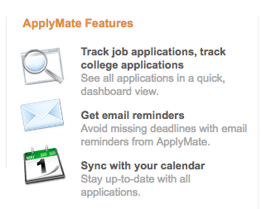
Think Aloud Notes:
Most of the users could carry out the tasks easily. But many took longer time to do task #4, which was to sync the job application to a calendar app. It was not evident where to navigate. In order to sync, users had to go to settings button.

Slide 5
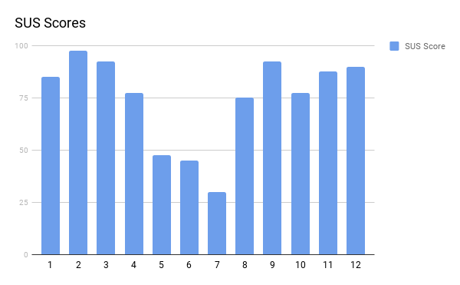
SUS Results
SUS scores varied from 30 - 97.5
Average SUS Score : 74.791666666667

Slide 6
Interview questions
1. Did you enjoy browsing through the website?
2. Which features did you like most?
3. What did you not like about the website?
4. Do you feel that it should include some other features?
Most of the users could carry out the tasks easily. But many took longer time to do task #4, which was to sync the job application to a calendar app. It was not evident where to navigate. In order to sync, users had to go to settings button.

